Slide 1

YoPo
Presented By :- (Group 12) Under the supervision of:-
Dr. Ashish Kumar Sahu
K. Hemanth Naik [2020UGCS013] Assistant Professor
Akhilesh Kumar Mishra [2020UGCS053] Department of Computer Science
Notes:
Good Afternoon Panel !! We are excited to share our final draft of Our project named YoPo - a real time yoga pose detection Application.

Slide 2
PROJECT AIM
The Aim of our project is to make a Yoga Pose Detector that will work as a personal trainer.
A person can perform different set of Yoga Poses and our Model will detect the correct pose using Machine Learning Technique.
Notes:
So basically we made a personal trainer model with the help of Machine learning that identifies the yoga poses.

Slide 3
What Motivated Us…..
+
Everyone can not afford a personal trainer to perform the daily yoga activities.
+
Without guidance most of the people are performing wrong yoga postures. Doing correct Yoga posture can only benefits a person.
Notes:
What motivated us to build this project ?
So in this world of too much stress and busyness everyone wants to stay fit and if they even get some leisure time they are performing yoga but they are not sure whether they are performing the correct yoga pose or not and as we know that if yoga are performed in wrong way they can lead to consequences so We are challenged to build such project one of the other reason was the economic motivation as not everyone can join yoga classes and keep a personal trainer so our model will play a vital role in that as it can be installed in any device lash with camera and perform yoga at their comfort.

Slide 4
What’s New…..
Last Semester we have worked on the same project YoPo - A real time Yoga Pose Detector. We continued with the same project this year with some major updation.
We have increased our training DataSet from 100-120 Imgaes per pose to 300-400 images per pose.
Increased accuracy from 92.34% to 96.48%
Our model is now able to detect more poses [ Added two more poses Warrior & Triangle].

Slide 5
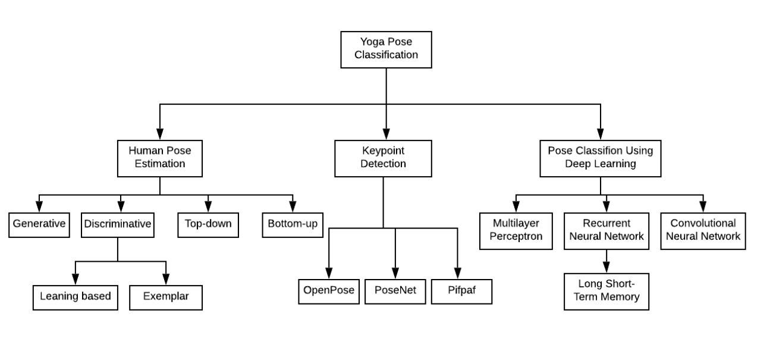
LITERATURE SURVEY
MoveNet
Notes:
78% accuracy -multi person OpenPose

Slide 6
LITERATURE SURVEY
Pose Estimation and Classification for Yoga Asanas using Deep Learning [1]
The Researcher have used Deep Learning method to classify Pose detected by the key points obtained from the help of PoseNet. We took idea about the Deep Learning technique used to classify Different pose from this Paper
REAL TIME DETECTION AND CLASSIFICATION OF YOGA POSE USING TENSORFLOW MOVENET [2]
In this research paper the researcher has implemented MovNet model to detect the yoga pose. We took idea from this and broaden our training model for more poses.

Slide 7
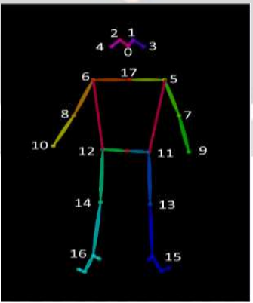
MovNet
It is a Tensorflow Module that helps to findout the flexicon points (here 17 points).
Using Tensor flow MoveNet to detect the key points from the images and then convert these key points to CSV files.
The converted key points (CSV file) is feed into the neural network for classification.

Slide 8
Objective
To detect major flexion points of human body
Classification of frame data into different yoga poses
Live feed capture and detection of pose and movement
Accuracy measurement of yoga pose in real time.
Notes:
Main objective of our model is to find the flexion points using Movenet model and then comparing it with the trained model flexion point (correct yoga)

Slide 9
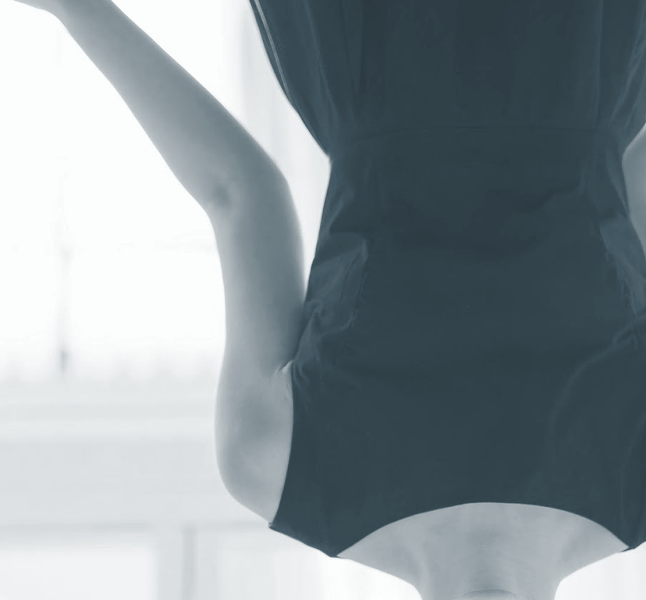


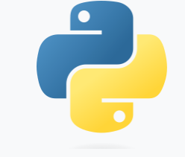


Software Used

Slide 10
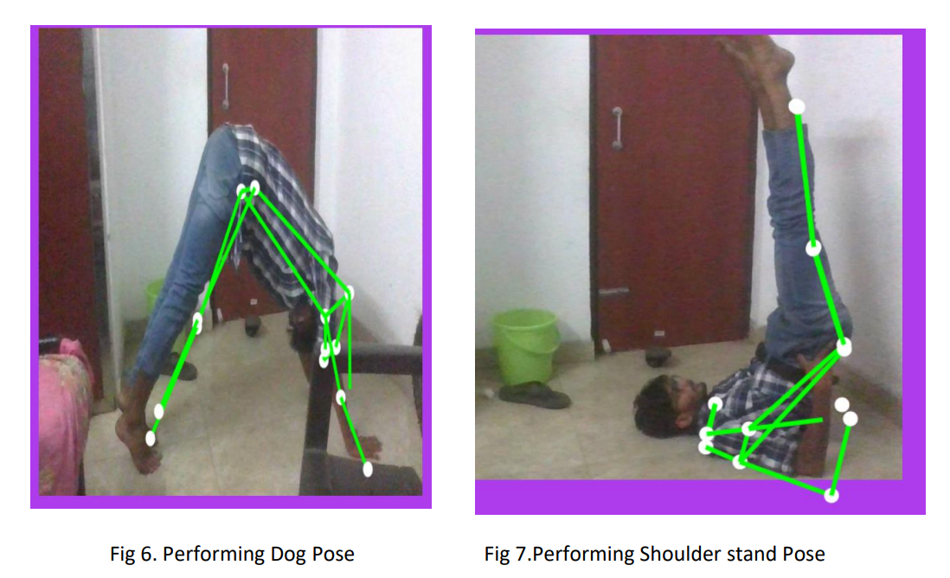
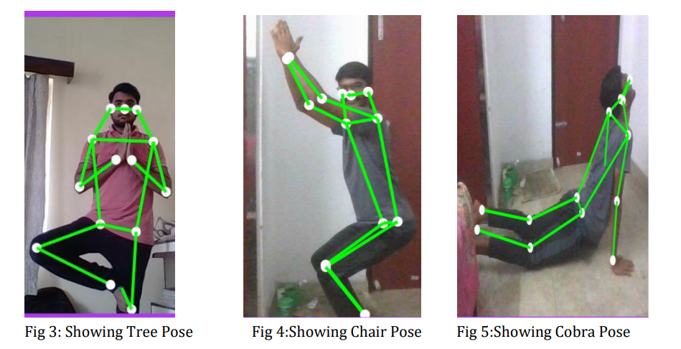
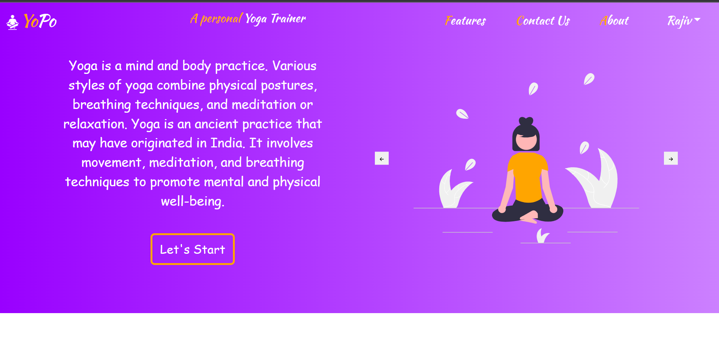
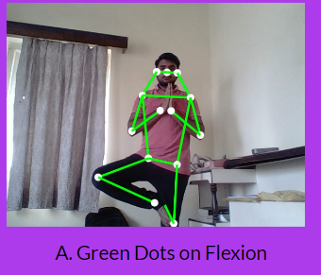
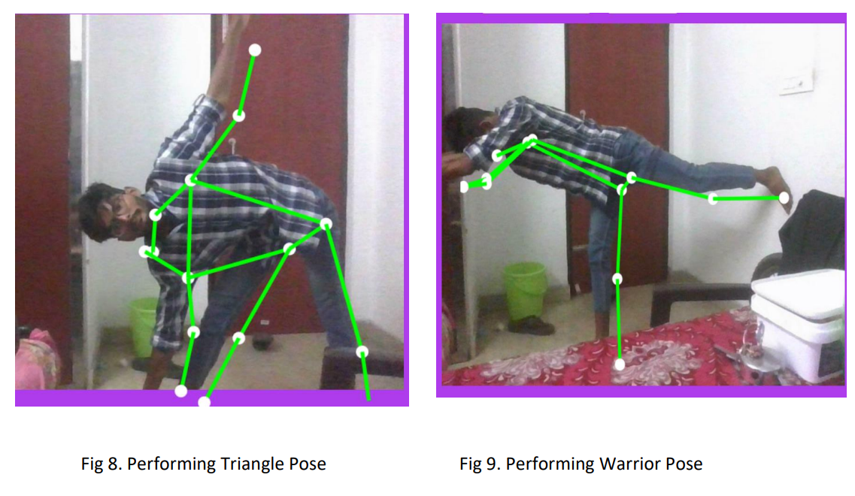
Some SnapShots of our Project
Live Demonstration…..

Slide 11
Industrial Perspective
HEALTH SECTOR
Our Product can be prescribed by the doctors to different Patients
2. SPORTS SECTOR
Our Product can be used by Sports Academies and Schools
3. D2C SECTOR
Our Product can be used by any individual

Slide 12
Conclusion
Human pose estimation is different as it has to localize and assemble human body parts on the basis of an already defined structure of the human body.
Application of pose estimation in fitness and sports can help prevent injuries and improve the performance of people’s workout. suggests, yoga self instruction systems carry the potential to make yoga popular along with making sure it is performed in the right manner.

Slide 13
FUTURE WORK
1. After going through various position detector modules available in the market we have decided to work with the MoveNet Module .
2. We have planned to get total of 6-8 Yoga Pose in our WebApp.
3. Enhancing our WebApp and making the website more responsive to different viewport.

Slide 14
THANK YOU

